Slide 1


Slide 2








Click on the colored buttons to start getting to know them!

Slide 3
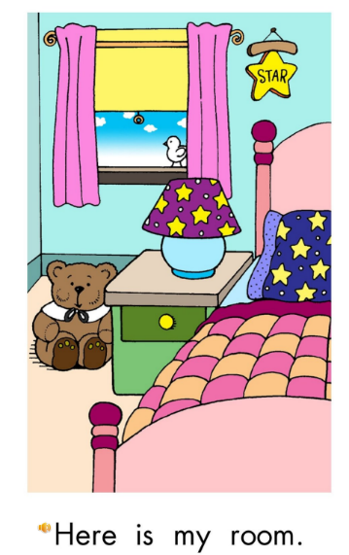
Return

Slide 4
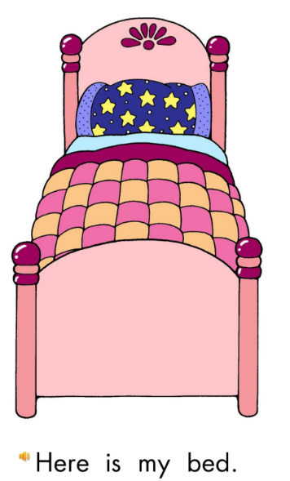
Return

Slide 5
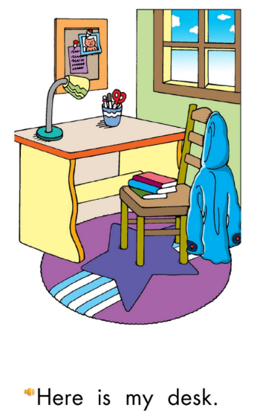
Return

Slide 6
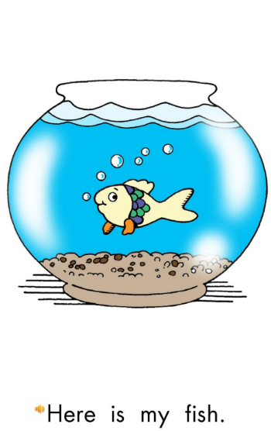
Return

Slide 7

Return

Slide 8
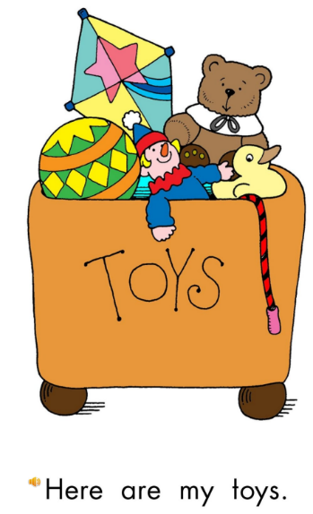
Return

Slide 9

Return

Slide 10
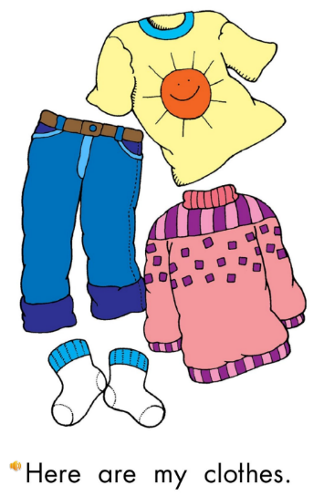
Return

